Slide 1
TRUE POSTURE
Section 1 – Group 8
Hasan Basri Karslıoğlu 20210601033
Mehmet Bora Böcekoğlu 20220601010
Hüseyin Yontar 20210601067
Yekta Kağan Cananoğlu 20210601013
Okan Özyürekli 20220601054

Slide 2

OVERVIEW
1. About Project
2. Project Requirements
3. Process Model
4. Project Measurements
5. Project Tools
6. Stakeholders and Risks
7. Needs and Schedule
8. GUI

Slide 3

ABOUT THE PROJECT
Problem Definition
Sport is vital,and so are the risks
Many untrained people end up hurting themselves

Slide 4
Background Information
Hard to learn without help
Alternatives are not accessible enough

Slide 5

Objectives
Target Area or Movement Request
Movement Accuracy Feedback
Promoting Correct Exercise Form
Movement Timing Accuracy

Slide 6

FUNCTIONAL REQUIREMENTS
Target Area Selection
Movement Monitoring and Analysis
Validation by Professional Trainers
Timing Accuracy Assessment
User Membership System
Cloud-Based Image Processing
Progress Tracking
Optimal Camera Position Feedback
Real-time Feedback
Goal Setting

Slide 7

NON-FUNCTIONAL REQUIREMENTS
Reliability
Performance
Accessibility
Security
Compatibility
Availability
Usability
Power Consumption
Environmental Considerations
Maintenance and Upgrades
User Membership System

Slide 8
NECESSARY NEEDS FROM THE ORGANIZATIONAL PROCESS
Budget and Sources
Budget of the project must be determined
Clear Project Objective
Team members must understand project objectives
Harmony of Process
Team members must divide objectives into sprints

Slide 9

NECESSARY NEEDS FROM THE ORGANIZATIONAL PROCESS
Collaborative Team
Project team must communicate efficiently
User Feedback
Project team must understand customer’s expectations
Project Documentation
Clear documentations of project artifacts must be maintained

Slide 10

Team Competencies and Training
Project team must communicate efficiently
Legal and Regulatory Compliance
The organization must be reliable
Adaptable Approach
Project must be adaptable to customer needs

Slide 11

SOFTWARE PROCCESS
Software Process Name: Agile Model (with Scrum Framework)
Software Process Description:
Scrum is a lightweight framework that encourages teamwork and flexibility. Scrum can be applied to both project management and development.

Slide 12

SOFTWARE PROCESS MODEL
After the creation of the product backlog, sprints will be divided into eight parts:
Image Processing and Its Algorithm Design
Database Design for User Data and User’s Progress
Design and Registration System
Cloud Computing for Premium Members
Area Selection and Posture Correctness
Progress Tracking
Debugging
Releasing

Slide 13
SOFTWARE PROCESS MODEL
1) Image Processing and Its Algorithm Design
Duration: 4 weeks
The team members will work on image processing for the user’s workout video.
2) Database Design for User Data and User’s Progress
Duration: 2 weeks
The database will be created for the user’s data and progress.

Slide 14


SOFTWARE PROCESS MODEL
3) Design and Registration System
4) Cloud Computing for Premium Members
Duration: 2 weeks
The registration screen will be designed and check the user information on the database.
Duration:3 weeks
The team will create a cloud computing system for users with outdated devices.

Slide 15

SOFTWARE PROCESS MODEL
5) Area Selection and Posture Correctness
Duration:2 weeks
The target area selection part will be created.
6) Progress Tracking
Duration:1 week
The team will create a progress tracking section.

Slide 16

SOFTWARE PROCESS MODEL
7) Debugging
Duration:1 week
The team will focus on enhancing and debugging the app.
8) Release
Duration:1 week
The team will complete the final preparations for the app's launch.

Slide 17
REASONS TO CHOOSE THIS MODEL
Reduced Risk
Continuous Improvement
Faster Delivery to Market
Transparency and Stakeholders

Slide 18
SOFTWARE MEASUREMENTS
Questions and identified measurements
How much space does the application take?
How much code has been reused?
How stable does cloud computing work?
How many times has the code been modified or deleted?
How many hours are spent for each sprint while developing this project?
How smoothly does the application work?

Slide 19
Questions and identified measurements
Is the application easy to use?
How many people have worked on this project?
What was the total cost of the project?
How accurately does the application detect the user's posture?
What is the size of the project's database?
How high is the source utilization during peak usage?

Slide 20
MEASUREMENT TYPES
Cost
Effort/Productivity
Performance
Defect
Reuse
Number of Changes
Space

Slide 21
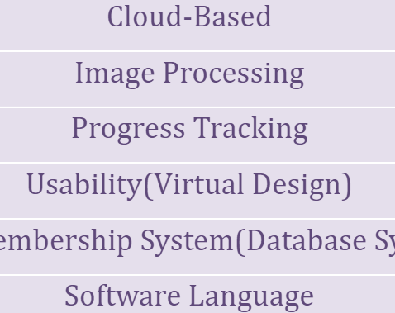
SOFTWARE TOOLS

Slide 22
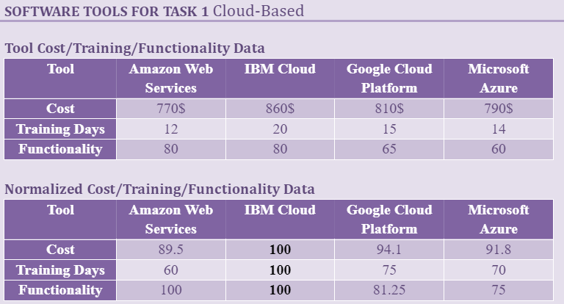

Slide 23
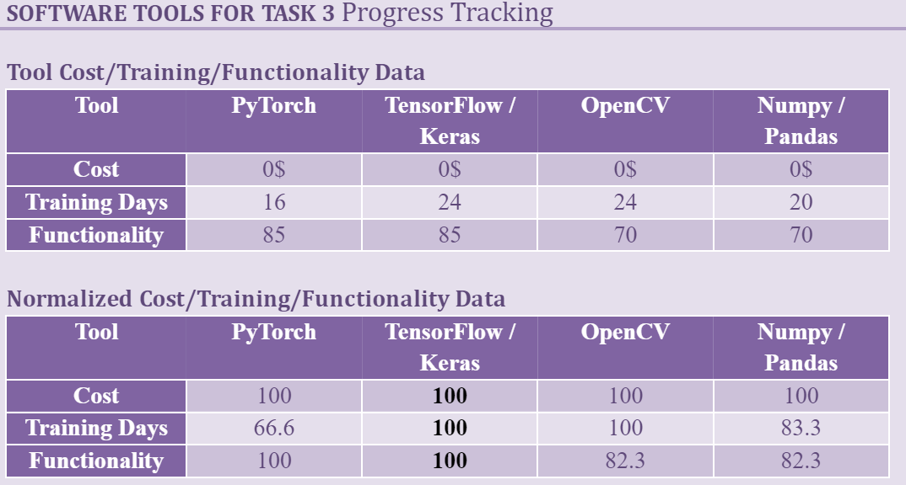

Slide 24
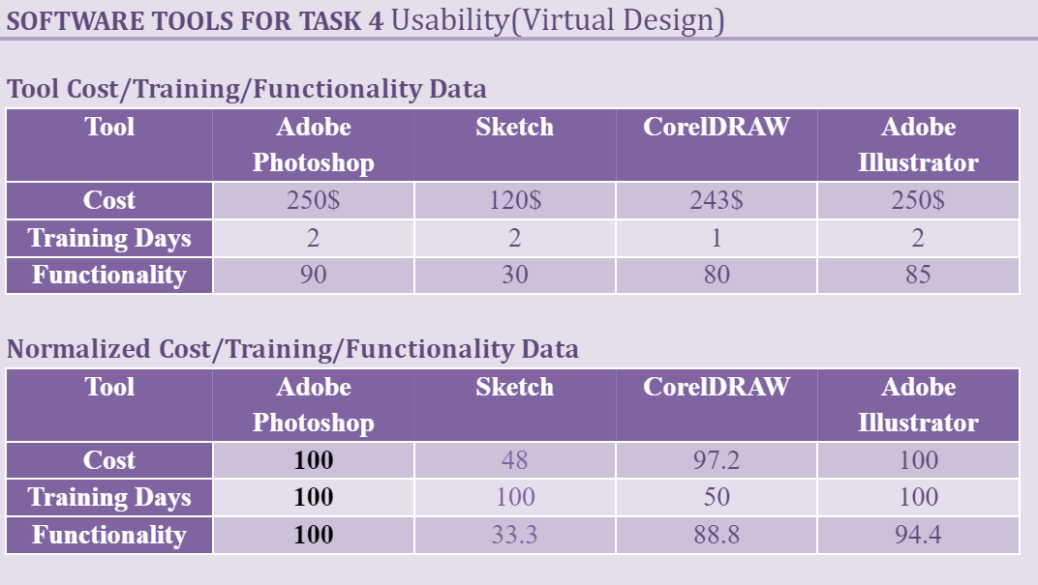

Slide 25
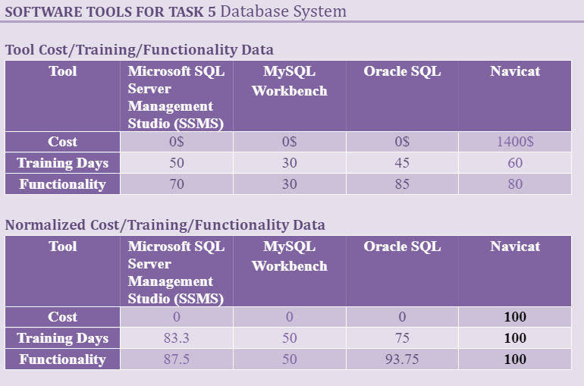

Slide 26
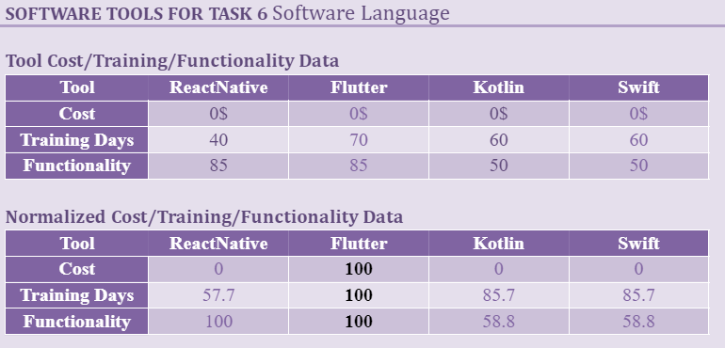

Slide 27
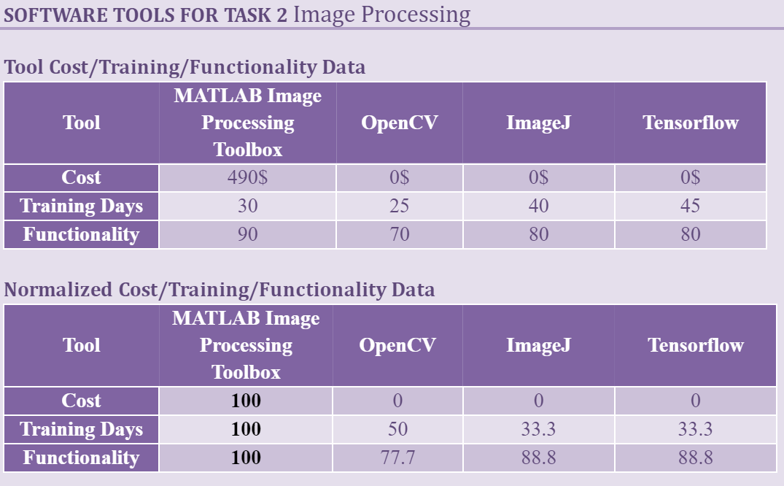

Slide 28
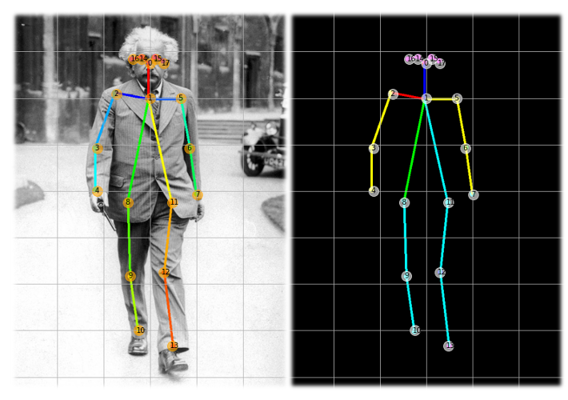
IMAGE PROCESSING
Tensorflow
TF Pose Estimation

Slide 29
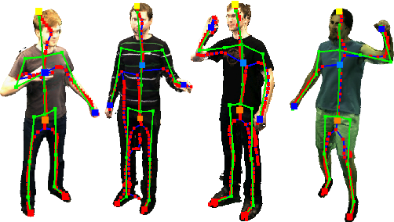

Slide 30
competitor
STAKEHOLDERS
Academic Researchers
Investors or Funders
Personal Trainers
Quality Assurance and Testing Teams
Legal Advisors
Cyber Security Experts
Bodybuilding Competitor

Slide 31
PROJECT RISKS
Risks
Combined Rank
3
4
9
10
11
12
13
13
16
20
21
Lifetime Estimation Errors
Motion Detection Accuracy
Security Vulnerabilities
Algorithm Performance and Accuracy
Communication Problems
Cloud Computing Costs
Requirements Volatility
Cloud Providers
Inefficient Backend
Debugging
Testing

Slide 32
SOFTWARE NEEDS
Compiler /Interpreter /Development Kits
Python & PyTorch
React Native
AWS SDK
JDK

Slide 33
IDE’s / CLI’s
MATLAB
Android Studio
PyCharm IDE
Amazon Command Line Interface
SOFTWARE NEEDS

Slide 34
SOFTWARE NEEDS
Testing
Jest
PyUnit
Version Control System
Git
GitHub Desktop

Slide 35
SOFTWARE NEEDS
Build Automation Tool
Gradle
Database Management System
Oracle Database

Slide 36
SOFTWARE NEEDS
Project Management System & Collaboration Tool
Microsoft Project
Microsoft Teams

Slide 37
HARDWARE NEEDS
Computers
Networking Equipment
Test Devices
Server
Cameras
Back-up Storage
Power Units

Slide 38
SUPPORT NEEDS
Technical Support
Partnerships and Collaboration
Feedback Providers
Legal Background Checks
Oracle Support
Microsoft Support
AWS Support

Slide 39
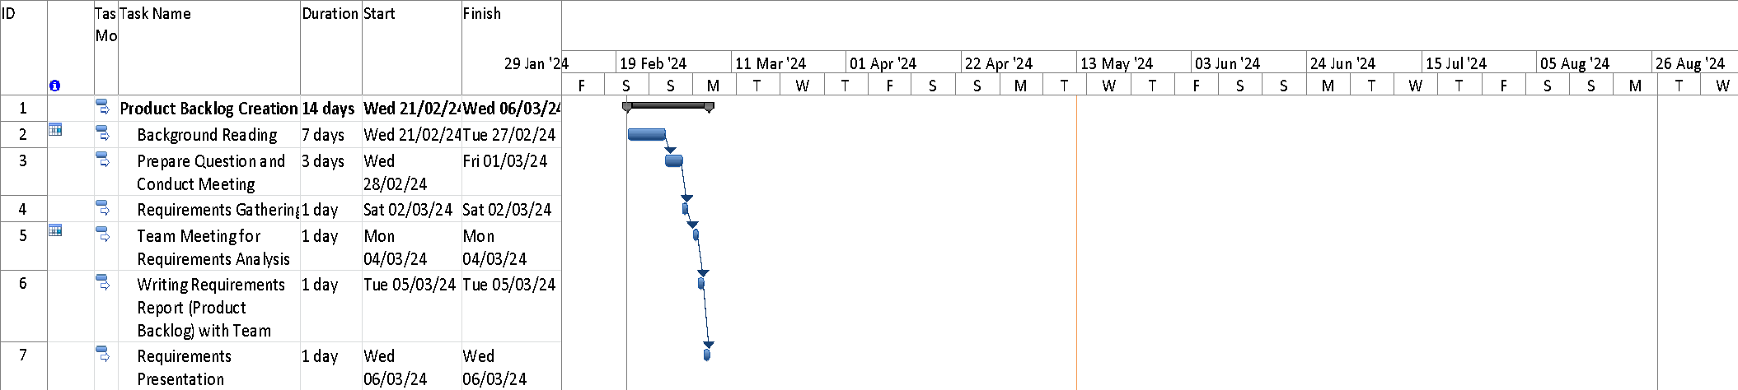
PROJECT SCHEDULE

Slide 40
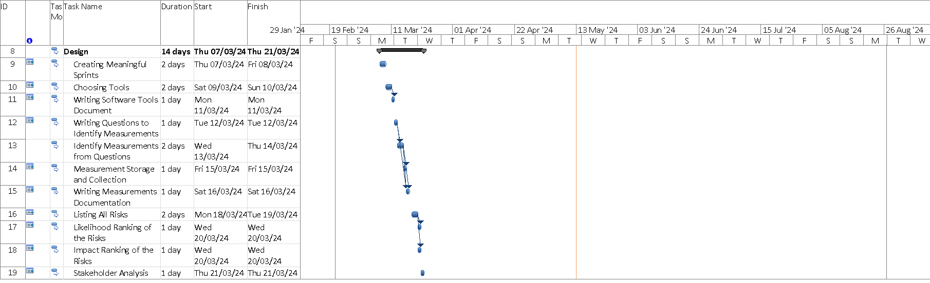
PROJECT SCHEDULE

Slide 41
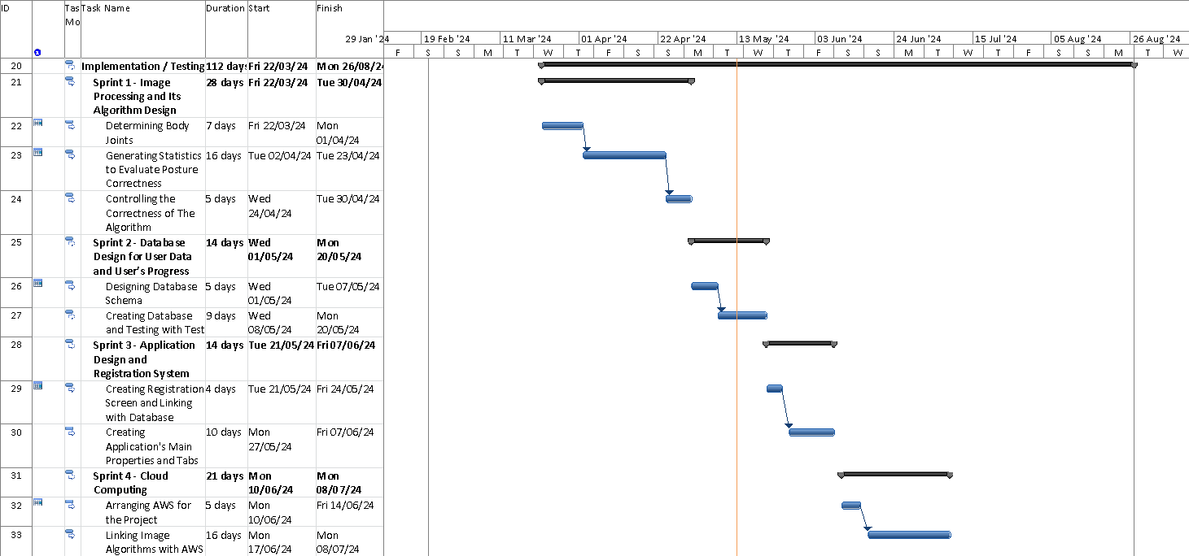
PROJECT SCHEDULE

Slide 42
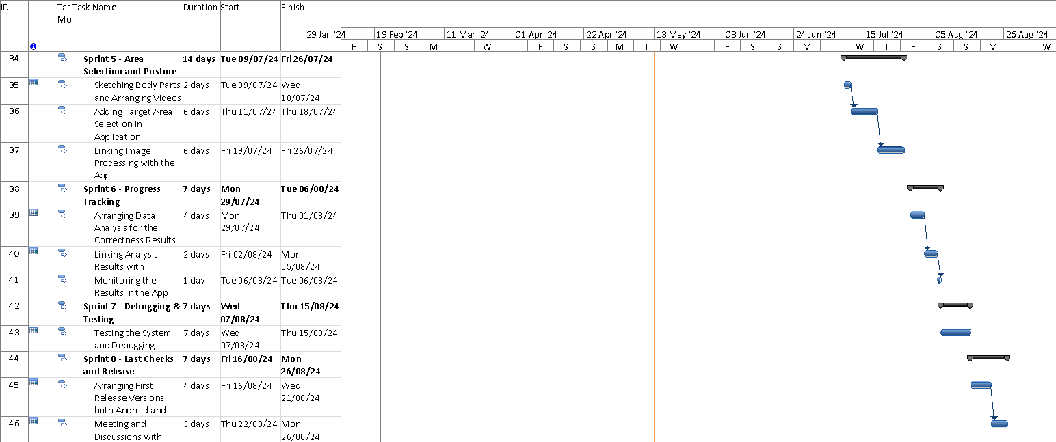
PROJECT SCHEDULE

Slide 43
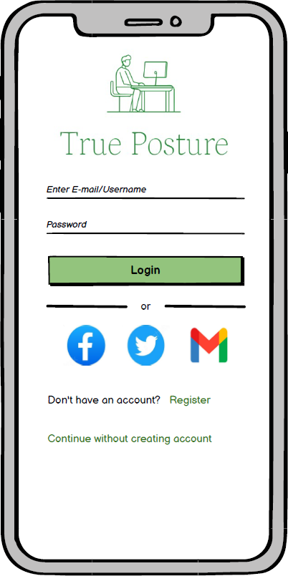
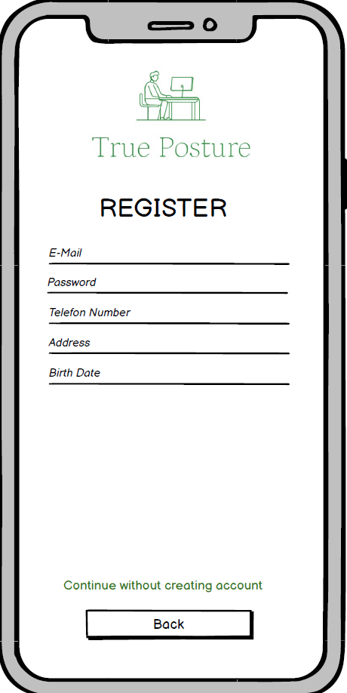
PROJECT GUI

Slide 44
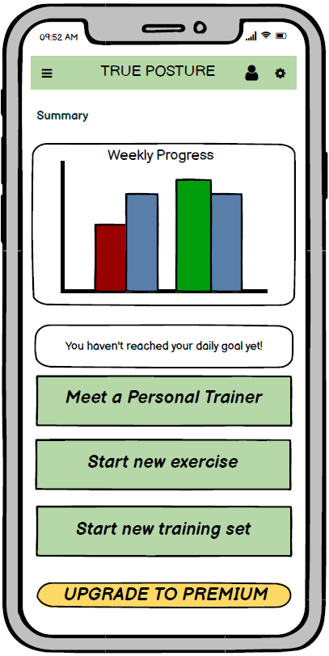
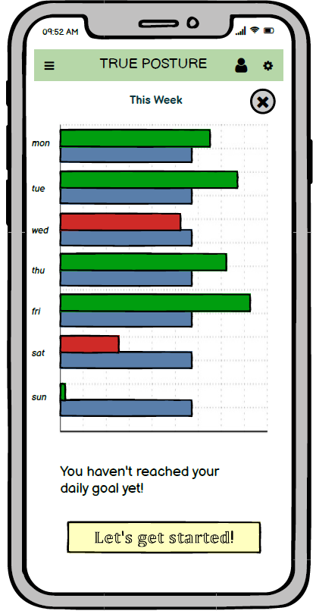
PROJECT GUI

Slide 45
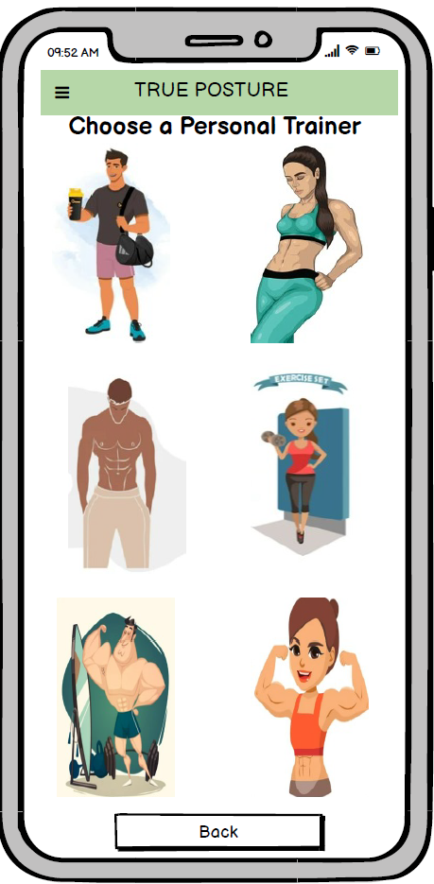
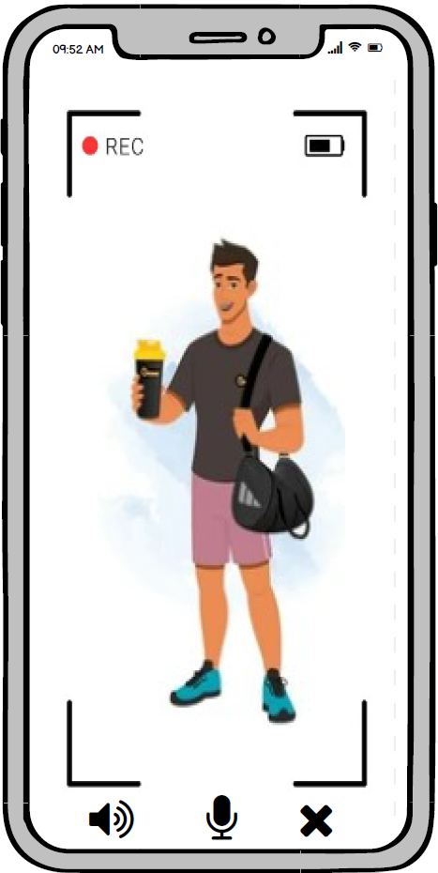
PROJECT GUI

Slide 46
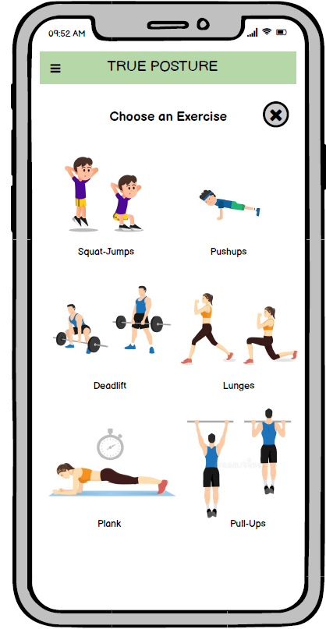
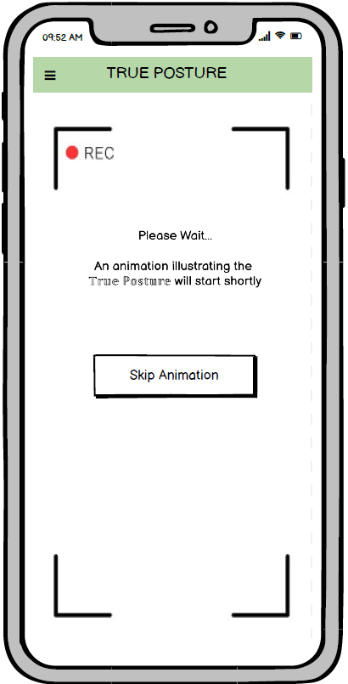
PROJECT GUI

Slide 47
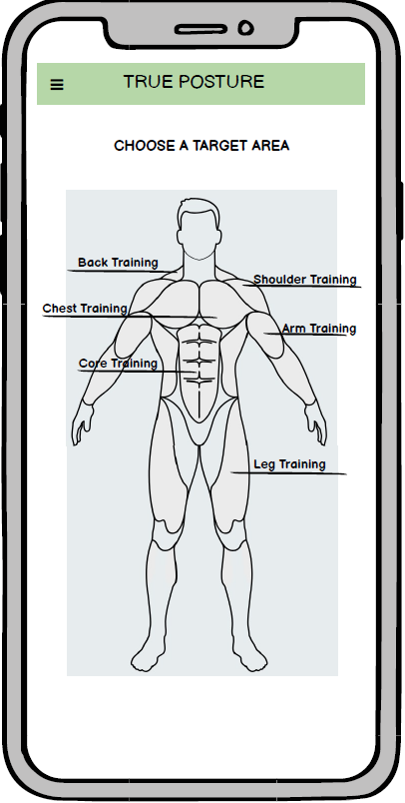
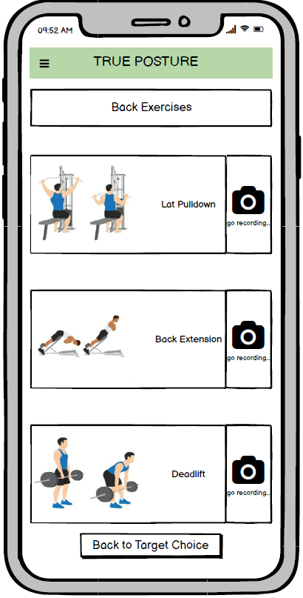
PROJECT GUI

Slide 48
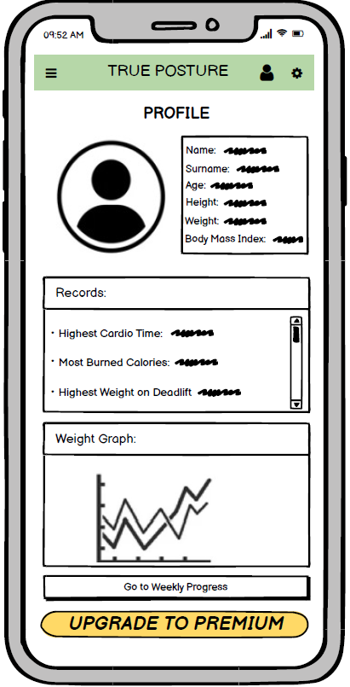
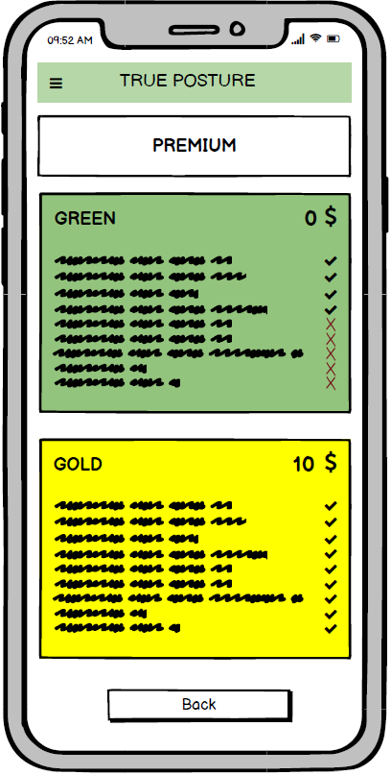
PROJECT GUI

Slide 49
